Slide 1


DATA SCIENTIST SALARY ANALYSIS
BY SHREYAS G N

Slide 2


TODAY'S AGENDA
1
INTRODUCTION
2
INSIGHT VISUALISATION
3
CONCLUSION

Slide 3

INTRODUCTION
A salary is a regular payment by an employer to an employee for employment that is expressed either monthly or annually but is paid most commonly on a monthly basis, especially to white collar workers, managers, directors, and professionals.Salary benchmarks provide data points, whether it is worth it or not to pay an employee above the average salary.

Slide 4


KEY ATTRIBUTES
work_year:The year the salary was paid.
experience_level: The experience level in the job during the year.
EN > Entry-level / Junior
MI> Mid-level / Intermediate
SE > Senior-level / Expert
EX > Executive-level / Director
employment_type: The type of employment for the role.
PT > Part-time
FT > Full-time
CT > Contract
FL > Freelance

Slide 5
salary: The total gross salary amount paid.
salary_currency: The currency of the salary paid as an ISO 4217 currency code.
salaryinusd: The salary in USD.
employee_residence: Employee's primary country of residence during the work year as an ISO 3166 country code.
remote_ratio:The overall amount of work done remotely.
company_location: The country of the employer's main office or contracting branch.
company_size: The median number of people that worked for the company during the year.

Slide 6
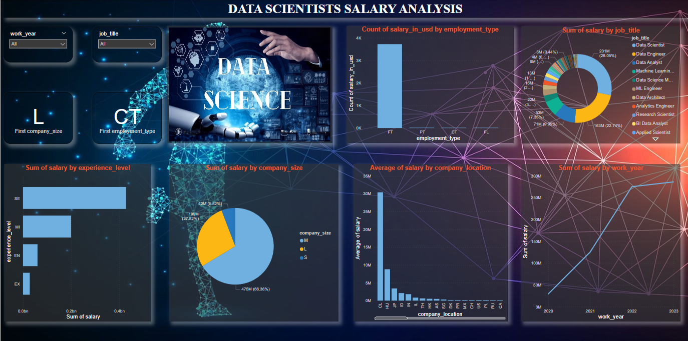

Slide 7

CONCLUSION
Most of those working in the field of data science are
senior level having high sum of salary .
Small sized companies have lowest sum of salary among all .
The most hiring year for those working in the field of data science
is 2023 .
The most of full time's employees is in senior level .

Slide 8
Medium sized companies have the higest salary as comapred to all other sized
companies .
Employement opportunities gradually increases from 2020 – 2023 .
The most employment type is full time .

Slide 9

Thank you very much!

